Slide 1
MIS 221
Lab 3 – Methods and Decision Structures

Slide 2
Methods - Recap
A method is a group of statements that exists for the purpose of performing a specific task within a program.
Most programs are large enough to be broken down into several subtasks.
Divide and conquer: It’s easier to tackle smaller tasks individually.
Value returning vs. Void

Slide 3
Methods - Recap
Sometimes, one or more pieces of data need to be sent to a method.
Argument - any piece of data that is passed into a module when the module is called.
Parameter - variable that receives an argument that is passed into a module.
The argument and the receiving parameter variable must be of the same data type.
Multiple arguments can be passed sequentially into a parameter list.

Slide 4
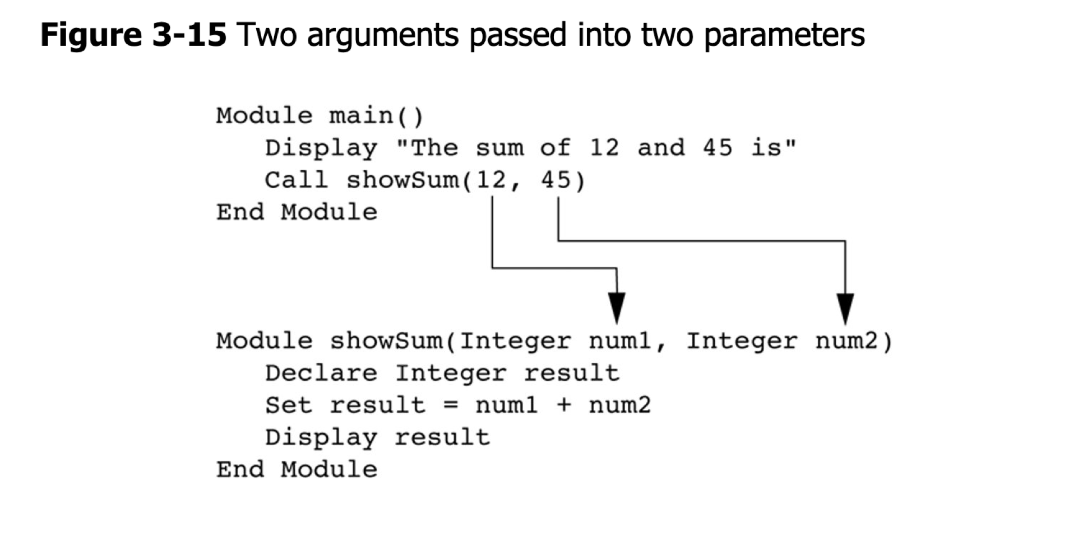
Methods - Recap

Slide 5
Decision Structures
A decision structure (or selection structure) allows a program to perform actions only under certain conditions
Different types of decisions include
If - also called single alternative (1)
If/else - also called dual alternative (2)
Case structure - multiple alternative decisions (3+)

Slide 6
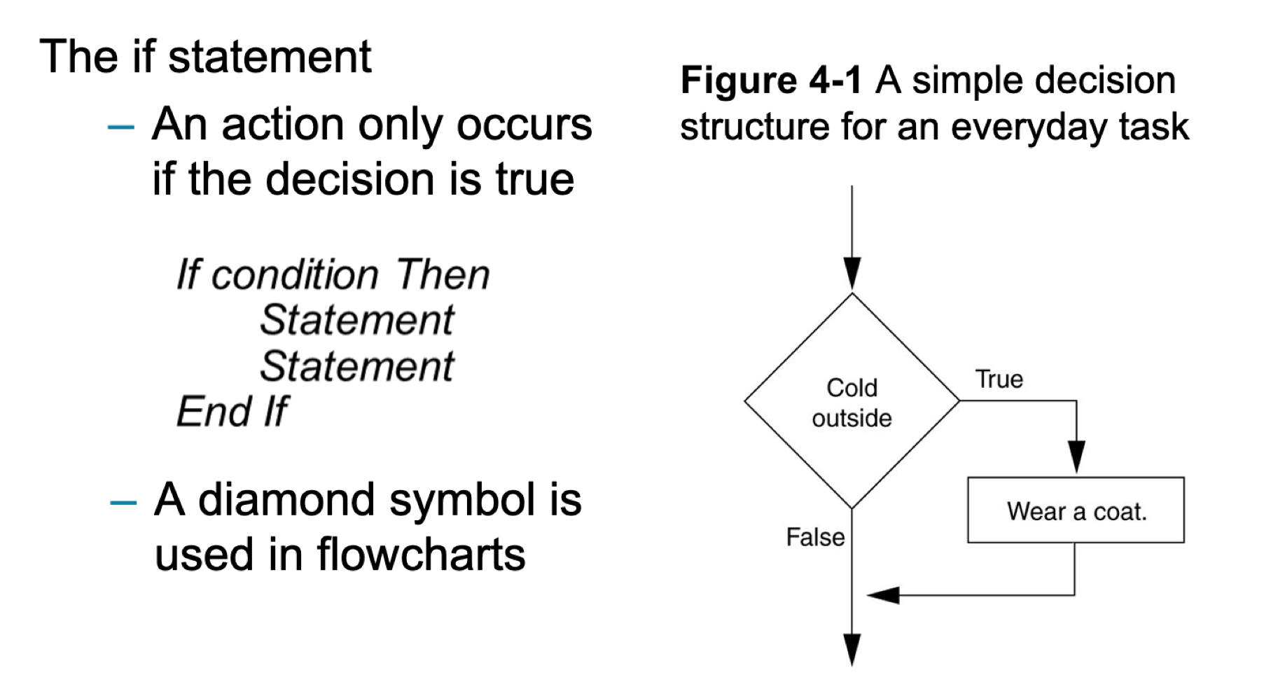
Decision Structures

Slide 7
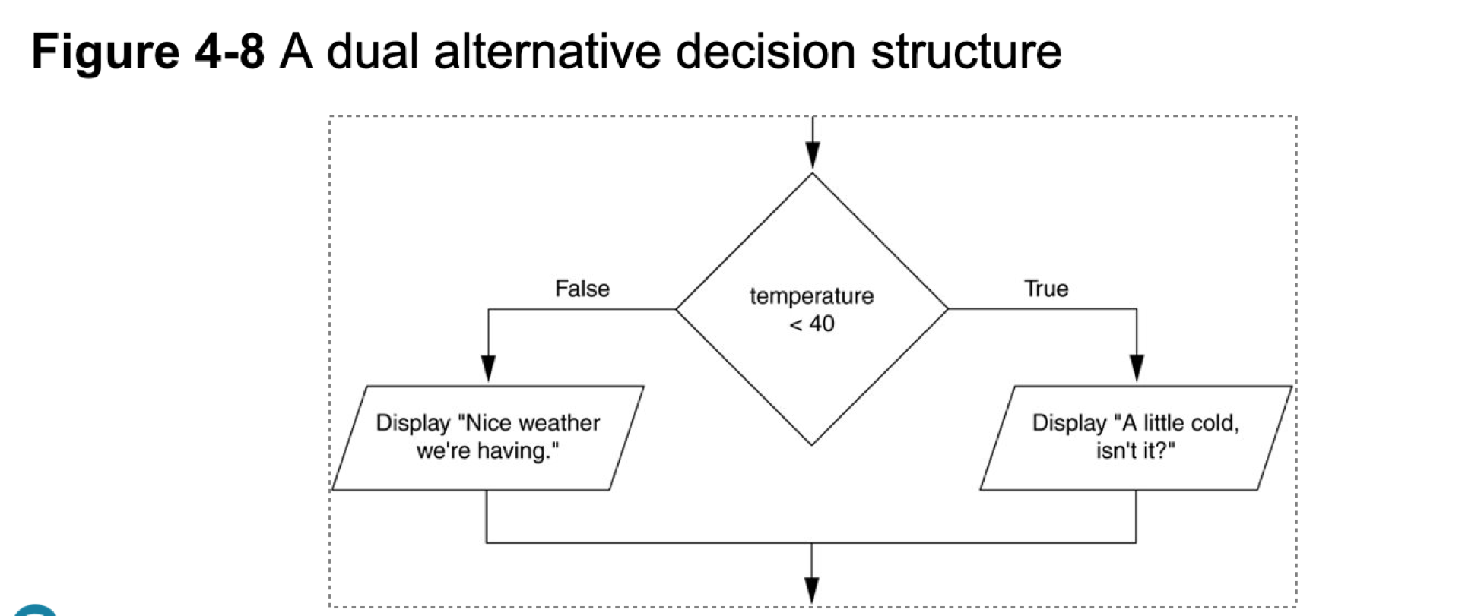
Decision Structures

Slide 8
Lab Requirements
The "Mountain Summit Challenge" application helps adventurers pick a mountain to climb based on their preferred difficulty level. The program also suggests the best season to attempt the climb. Here's the flow of the application:
Prompt the user for their preferred difficulty level of mountain climbing (Easy, Moderate, Difficult, Expert).
Based on the difficulty level, the program will suggest a suitable mountain and the optimal season for climbing it (Listed on the next slide)

Slide 9
Mountain and Season Recommendations
Easy
Mount Fuji in late July to early September
Moderate
Mount Blanc in June to September
Difficult
Denali in June
Expert
K2 in June to August

Slide 10
Methods for Lab
The program should contain the following methods:
GetDifficultyLevel()
Prompts the user for the difficulty level of the climb they want to undertake and returns the value
GetMountainRecommendation(string difficultyLevel)
Determines the best mountain for climbing based on the difficulty level and returns it.
GetSeasonRecommendation(string mountain)
Determines the best season for climbing based on the mountain given returns it.
DisplayClimbingDetails(string mountain, string season)
Returns a message detailing the mountain climbing challenge, including the name of the mountain and the best season to climb it.

Slide 11
Reminder - Basic Github Commands
Reference the basic git video series for more details
git clone <url provided for assignment>
Pulls code from github and creates the project on your local machine.
git add .
Stages your changes
git commit –m”some message”
Commits your changes
git push
Pushes your changes to github

Slide 12
Administration
Due 2/5 at 2 pm
Worth 75 points in the Lab, Quizzes, and Participation category

Slide 13
GitHub Link
https://classroom.github.com/a/z4jd81Xw

